Slide 1

Final Assessment
Excel

Slide 2
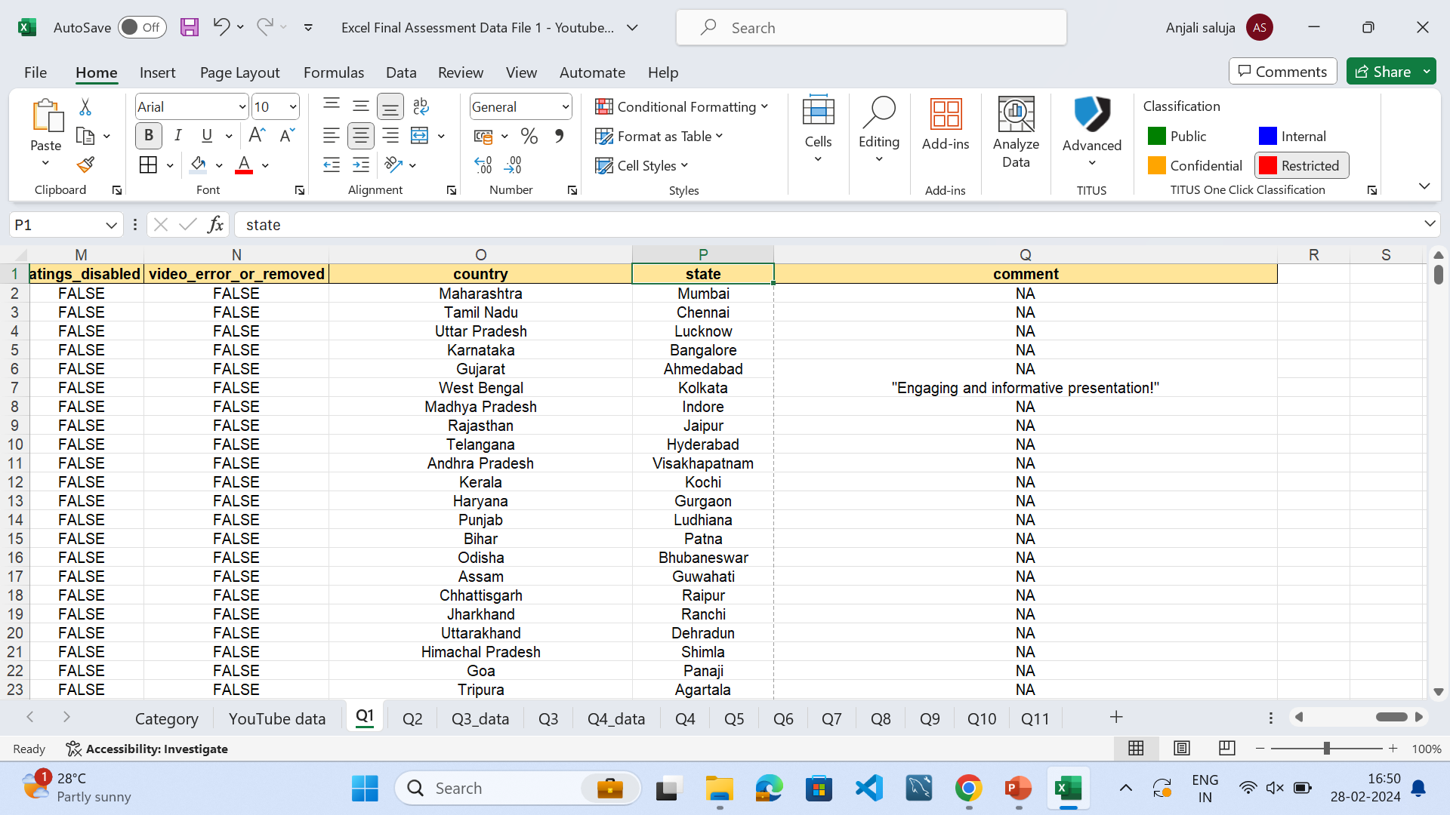
Task 1
To clean the data, steps are as follows:
Remove duplicates – In provided dataset, we don’t have duplicates
Find blank values =COUNTBLANK(A1:Q16308) In our dataset, there were blank values in comment.
Fill or remove blank values- we can’t remove comment column as it can be used for sentiment analysis, therefore we will fill the blank values with NA.

Slide 3
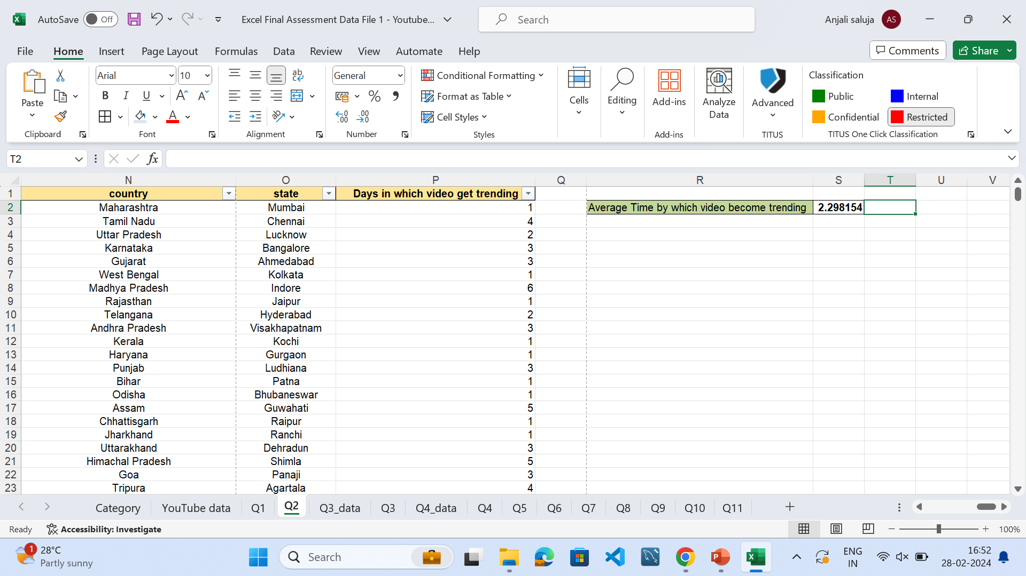
Task 2
Create a new column to find the difference between published and trending date
Using formula: =AVERAGE(P2:P16308) Find the average time video takes to get in trending list.

Slide 4
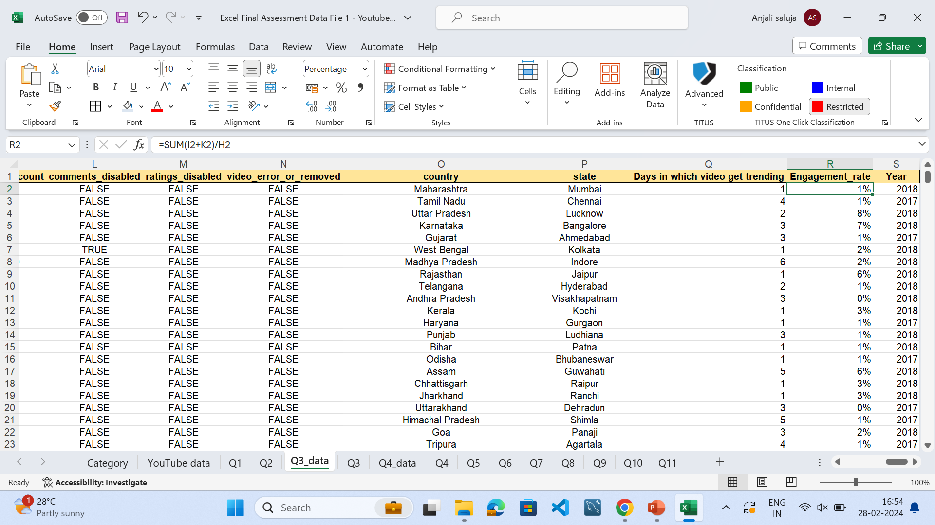
Task 3
Create new column: Engagement rate =(likes+comment_count)/views
Group unique categories
=UNIQUE('Q1'!E2:E16308)
3. Average Views
=AVERAGEIF('Q1'!E:E,'Q3'!A2,'Q1'!G:G)
4. Engagement Rate:
=AVERAGEIF(Q3_data!E:E,'Q3'!A2,Q3_data!R:R)
Category_id | Average Views | Engagement_rate
30 | 3862190.00 | 1%
20 | 3436401.95 | 5%
15 | 2490776.00 | 8%
10 | 2017880.62 | 2%
1 | 1800523.97 | 2%
17 | 1379353.41 | 1%
26 | 826816.93 | 2%
23 | 717054.79 | 5%
28 | 664622.35 | 10%
43 | 649225.54 | 1%
24 | 574766.28 | 1%
22 | 450423.36 | 2%
2 | 333265.38 | 2%
25 | 297358.62 | 1%
19 | 192907.75 | 2%
27 | 92618.26 | 6%
29 | 56945.04 | 3%

Slide 5
Task 4
After xlookup in the data to get category_name =XLOOKUP(E3,Category!A:A,Category!B:B)
Filter:
Channel Name |  |  | Punjabi Live Tv
Category_id |  |  | 25
Category_name |  |  | News & Politics
Total Views |  |  | 1061500

Slide 6
Task 5
Formula:
=CONCAT(C2,",",D2)
Example:
Unique
...पण पोट थोडंसं लहान दाखवा' मुख्यमंत्र्यांची राज ठाकरेंना मिश्किल विनंती,Punjabi Live Tv
...पण पोट थोडंसं लहान दाखवा' मुख्यमंत्र्यांची राज ठाकरेंना मिश्किल विनंती,ZEE 24 TAAS
' DESI HALCHAL '' || FUNNY VIDEO || KANGRA BOYS 2018,Kangra Boys

Slide 7
Task 6
Comments Disabled? | Average of comment_count
FALSE | 1537.61839
TRUE | 0

Slide 8
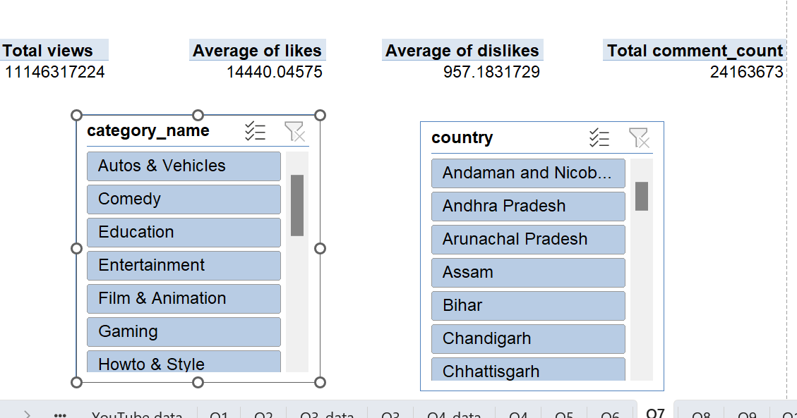
Task 7

Slide 9
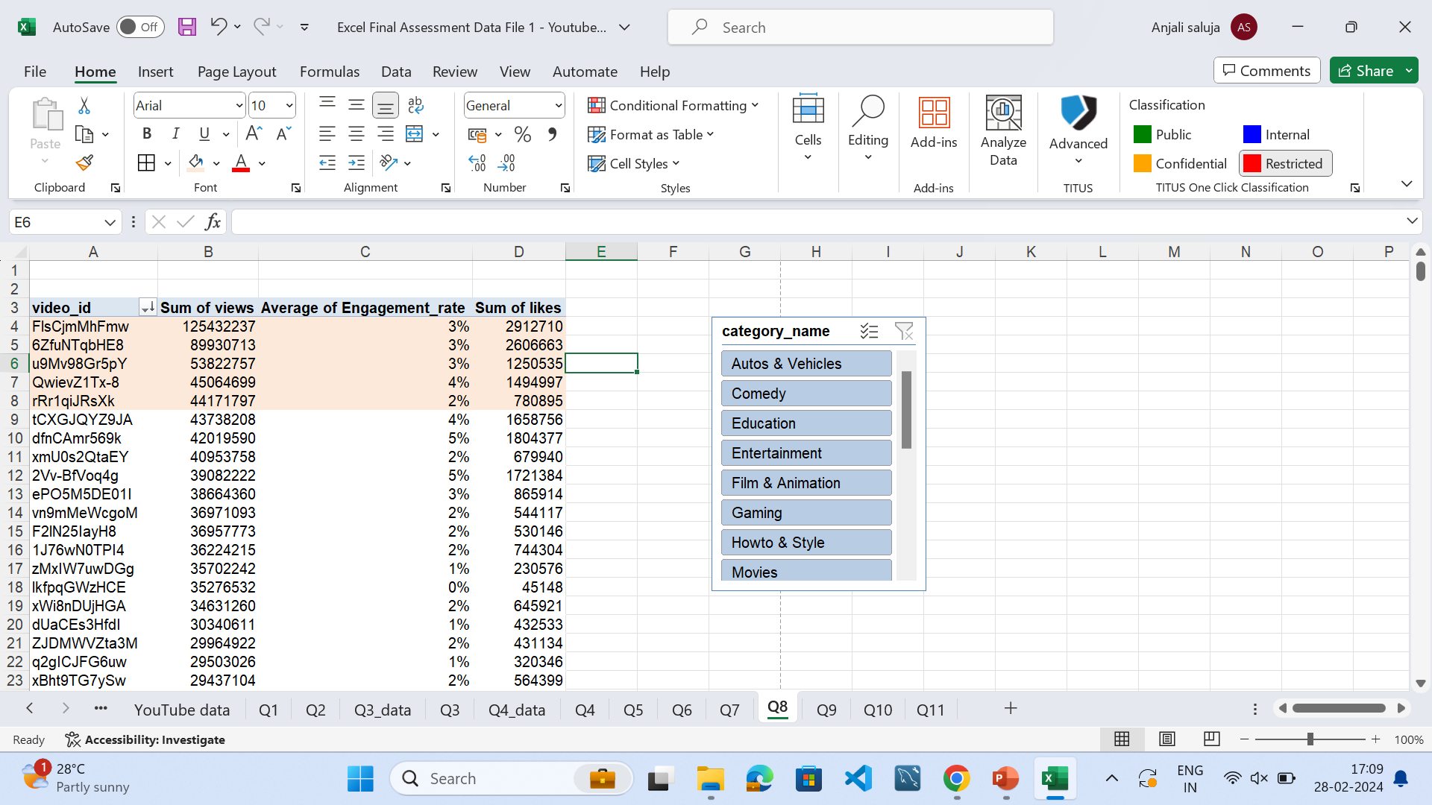
Task 8
Top 5 videos according to most likes:
video_id | Sum of views | Average of Engagement_rate | Sum of likes
FlsCjmMhFmw | 125432237 | 3% | 2912710
6ZfuNTqbHE8 | 89930713 | 3% | 2606663
u9Mv98Gr5pY | 53822757 | 3% | 1250535
QwievZ1Tx-8 | 45064699 | 4% | 1494997
rRr1qiJRsXk | 44171797 | 2% | 780895
We can use slicers to filter according to category

Slide 10
Task 9
Published_Date | Sum of views | Average of likes | Average of dislikes
2017 | 2700407997 | 13015.41 | 1052.68
Qtr2 | 58175 | 57.00 | 66.00
May | 58175 | 57.00 | 66.00
Qtr4 | 2700349822 | 13018.27 | 1052.89
Nov | 999488217 | 11936.35 | 643.35
Dec | 1700861605 | 13695.73 | 1309.33
2018 | 8445909227 | 14989.37 | 920.36
Qtr1 | 4729779734 | 12922.75 | 802.91
Qtr2 | 3716129493 | 18295.41 | 1108.25
Apr | 1376758448 | 18872.36 | 1022.14
May | 1577163430 | 15523.55 | 1105.07
Jun | 762207615 | 23904.00 | 1292.13

Slide 11
Task 10
Published_Year | Sum of views | Sum of likes | Sum of comment_count
2017 | 2700407997 | 59063929 | 6422378
2018 | 8445909227 | 176409897 | 17741295
Percentage growth | 313% | 299% | 276%

Slide 12
Task 11
Publish_date | Sum of views | Sum of likes |  | Retention Rate of Views | Retention Rate of Likes
2017
May | 58175 | 57
Nov | 999488217 | 20852796 |  | 1718072% | 36583853%
Dec | 1700861605 | 38211076 |  | 170% | 183%
2018
Jan | 1477413068 | 31968996
Feb | 1540024062 | 28218614 |  | 104% | 88%
Mar | 1712342604 | 33398949 |  | 111% | 118%
Apr | 1376758448 | 31799919 |  | 80% | 95%
May | 1577163430 | 31326527 |  | 115% | 99%
Jun | 762207615 | 19696892 |  | 48% | 63%

Slide 14
Task 13
Category | Sum of comment_count
Entertainment | 8969633
Music | 3450605
Science & Technology | 3381982
Comedy | 3117473
Film & Animation | 1196090
News & Politics | 1056430
People & Blogs | 1032463
Sports | 786327
Education | 455965
Howto & Style | 411823
Gaming | 178580
Shows | 64106
Autos & Vehicles | 26945
Pets & Animals | 21384
Religious | 7014
Movies | 4617
Travel & Events | 2236

Slide 15
Task 14

Slide 16
Task 15
correlation between views and likes
0.842435419

Slide 17
Task 16

Slide 18
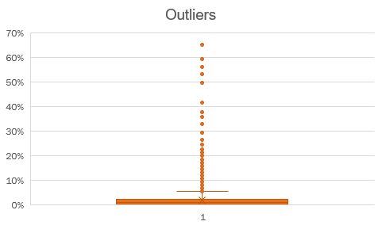
Task 17
Engagement rate outliers

Slide 19
Task 18

